Slide 1
Alpha Anywhere Demo and Q&A
Storing State Information
July 22, 2020

Slide 2
Ways to store state info
Session Variables
Stored on the server
Context.Session.myVar = “value”
Page Variables
Passed in URL
www.mysite.com/mypage.a5w?var1=value1
Component Variables
Stored on Client
{dialog.object}.__myDataVar = “value”

Slide 3
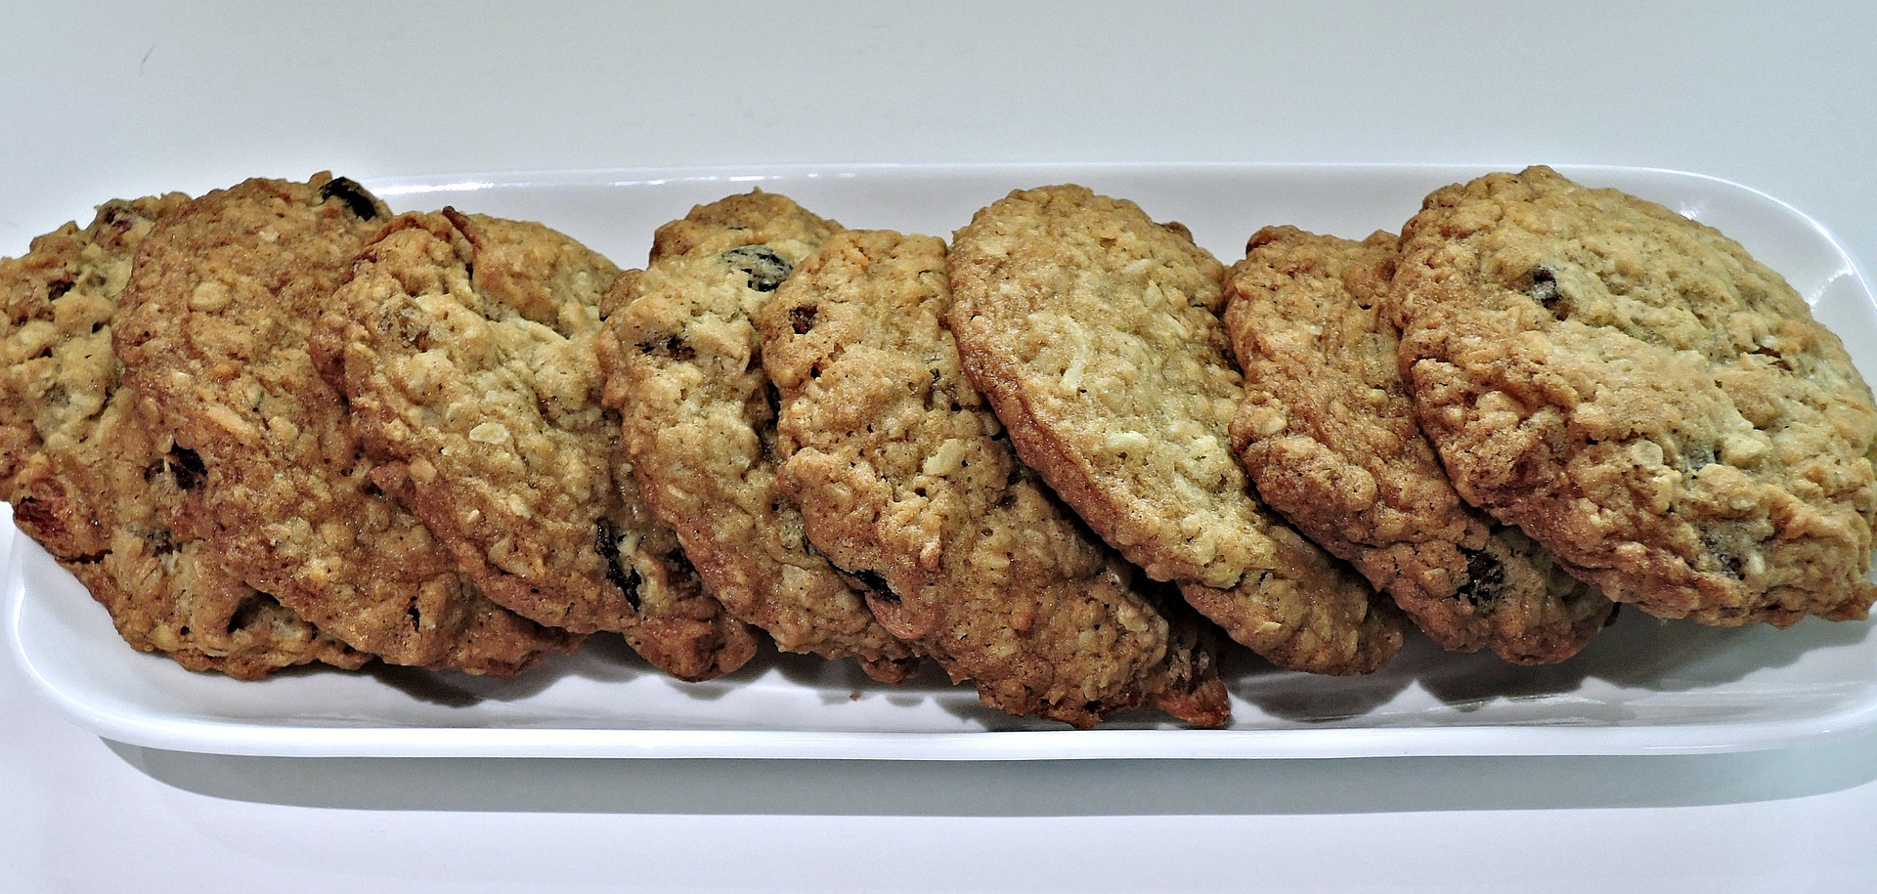
Cookies!

Slide 4
What are cookies?
A packet of data sent and received with every server request
Other Names: HTTP cookie, Web cookie, Internet cookie, Browser cookie

Slide 5
Types of Cookies
Persistent Cookie
Session Cookie

Slide 6
Persistent Cookie
A stored, permanent cookie
Has an expiration date in the future
Stays on the machine until the cookie expires or is manually deleted

Slide 7
Session Cookie
A temporary cookie
Does not have an explicit expiration date
Deleted when the user leaves the site or closes the browser

Slide 8
Reading Cookies
dim cookieName as c = "myCookieName"
if Context.Request.HasCookie(cookieName) then
dim cookie as System::Web::HttpCookie = Context.Request.GetCookie(cookieName)
cookie = Context.Request.GetCookie(cookieName)
' etc
end if
Notes:
Context.Request.HasCookie(): https://documentation.alphasoftware.com/documentation/index?search=api%20objects%20response%20object%20append%20cookie%20method
Context.Request.GetCookie(): https://documentation.alphasoftware.com/documentation/index?search=api%20objects%20request%20object%20get%20cookie%20method

Slide 9
Adding/Updating Cookies
dim cookieName1 as c = "MyPersistentCookie"
dim cookie1 as System::Web::HttpCookie = new System::Web::HttpCookie(cookieName1)
cookie1.HttpOnly = .t.
cookie1.Expires = *add_days(now(), 30) ‘In 30 days
cookie1.Value = "This is a peristent cookie!"
Context.Response.AppendCookie(cookie1)
dim cookieName2 as c = "MySessionCookie"
dim cookie2 as System::Web::HttpCookie = new System::Web::HttpCookie(cookieName2)
cookie2.HttpOnly = .t.
cookie2.Value = "This is a session cookie!"
Context.Response.AppendCookie(cookie2)
Notes:
Context.Response.AppendCookie(): https://documentation.alphasoftware.com/documentation/index?search=api%20objects%20response%20object%20append%20cookie%20method

Slide 10
Deleting Cookies
You cannot explicitly delete a cookie. Instead, you must set the cookie’s expiration to a date and time in the past:
if Context.Request.HasCookie(cookieName) then
dim cookie as System::Web::HttpCookie = Context.Request.GetCookie(cookieName)
cookie.HttpOnly = .t.
cookie.Expires = *add_days(now(),-1) ‘Yesterday
Context.Response.AppendCookie(cookie)
end if

Slide 11
HttpOnly?
HttpOnly = .t. means cookie cannot be accessed on the Client
Helps Mitigate Cross-Site Scripting
Notes:
See Mitigating Cross-site Scripting With HTTP-only Cookies: https://docs.microsoft.com/en-us/previous-versions//ms533046(v=vs.85)?redirectedfrom=MSDN

Slide 12
SameSite Policy
How cookies are shared with 3rd party services
Unset – Browser decides (usually Lax)
None – Cookies shared to 3rd party sites; Requires SSL (aka HTTPS)
Lax – Cookies allowed to be sent to top-level GET requests on 3rd party sites
Strict – Cookies are not sent to 3rd party sites
Must set to “None” or “Unset” if deploying PhoneGap Apps that communicate with the Application Server
cookie.sameSite = System::Web::SameSiteMode::None

Slide 13
Cookie Laws
Cookies are regulated
Many countries require you notify users how you use cookies on your site
Some countries require you maintain a record of consent
Some types of cookies are exempt – check with local laws in the areas where you deploy your application(s)

Slide 14

Coffee vector created by macrovector - www.freepik.com
Notes:
https://www.freepik.com/free-photos-vectors/coffee

